Slide 1
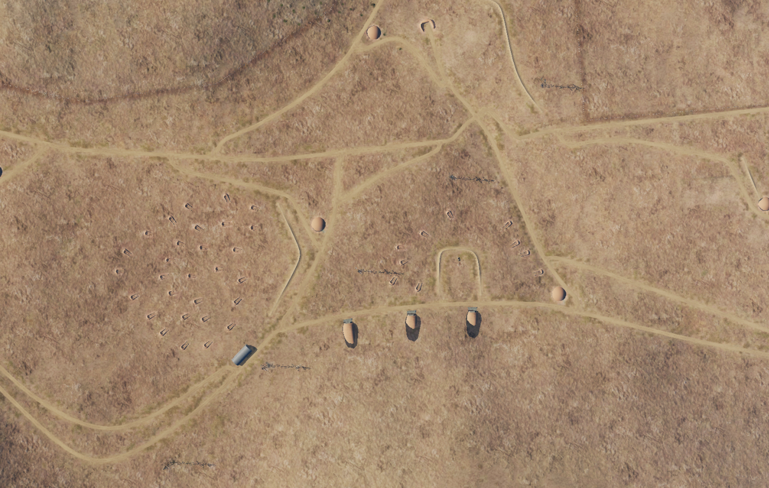

SYTGT061 Damascus Chemical Weapon Storage
N
061
DESIRED POINT OF IMPACT:
DPI 1 - N33 20.563 E036 21.555/ 2279ft / 1x GBU31 V3 (penetrator)
DPI 2 - N33 20.570 E036 21.640/ 2278ft / 1x GBU31 V3 (penetrator)
DPI 3 - N33 20.571 E036 21.721/ 2269ft / 1x GBU31 V3 (penetrator)
DPI 1: Chemical weapon storage (Category A)
DPI 2: Chemical weapon storage (Category B)
DPI 3: Chemical weapon storage (Category C)
NOTE: All coordinates TLE CAT 1.
1
2
3
No collateral damage concerns.

